Slide 1

Magnetic Drug Targeting, Ferrofluidics

Slide 2
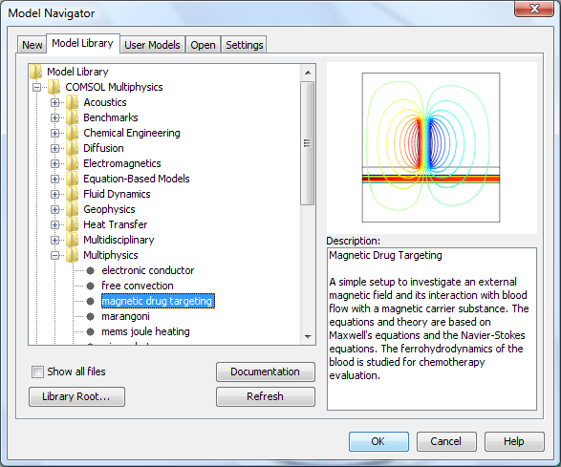
Magnetic Drug Targeting: Ferrofluidics

Slide 3
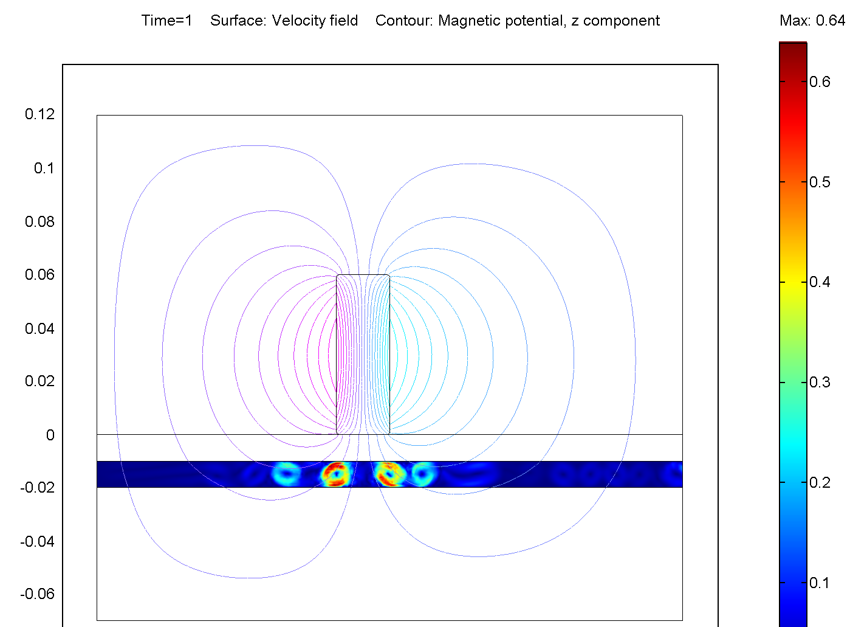
Magnetic Drug Targeting
Ferrofluids (magnetic liquids) as drug carriers
Drug targeting applications
Localized chemotherapy
Less damage to healthy cells
Multiphysics:
  Magntostatics
  Fluid Flow
This model was provided by Daniel J. Strauss, The Institute for New Materials, Inc., www.inm-gmbh.de

Slide 4
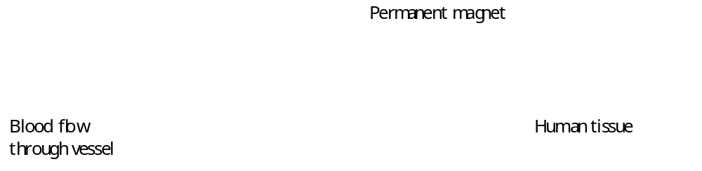
Geometry – 2D Approximation

Slide 5




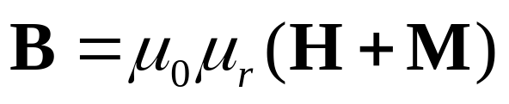
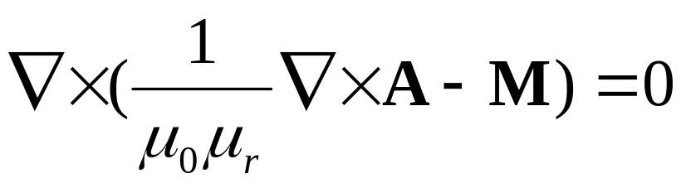
The Math behind the Magnetostatics
Maxwells law for the magnetic field and current (static)
Gauss’ theorem for the magnetic flux density (B-field)
Definition of a magnetic vector potential A
Constitutive relation to tie B-H (M is magnetization)
Combining the above equations
gives, for zero currents

Slide 6
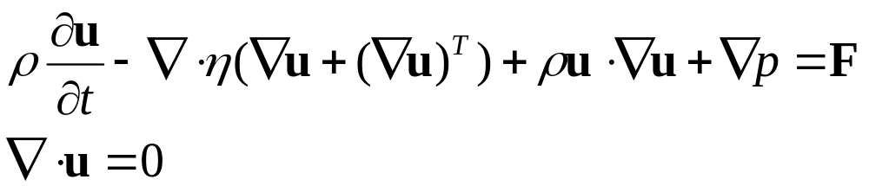
The Math behind the Fluid Flow
Incompressible Navier Stoke’s equations

Slide 7
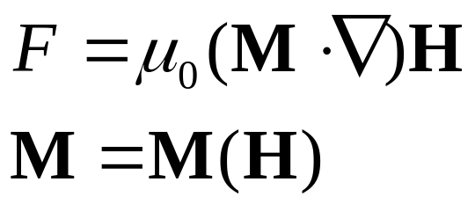
The Math behind the Fluid Flow
Incompressible Navier Stoke’s equations
Magnetic Volume Force for a Ferrofluid:
M = magnetization
H = magnetic field

Slide 8
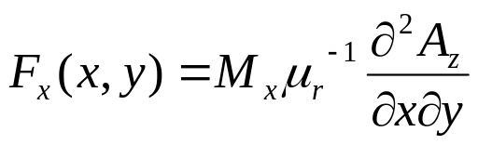
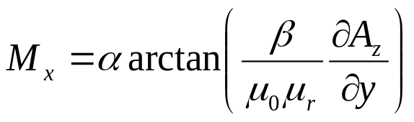
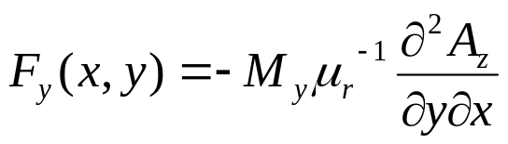
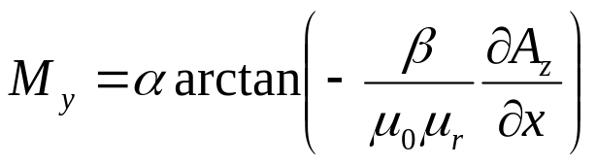
The Math behind the Fluid Flow
Magnetic Volume Force for a Ferrofluid
x,y, components

Slide 9
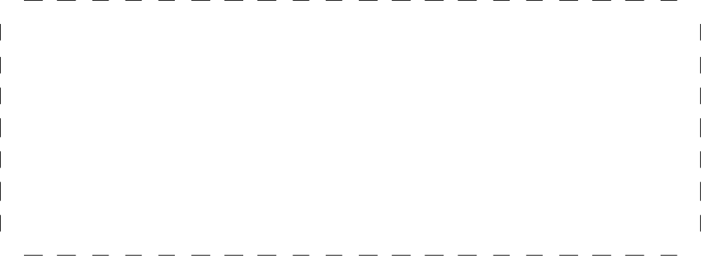

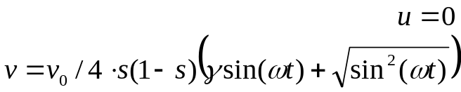

Boundary Conditions
Magnetostatics
  Reasonably far away from the magnet, magnetic insulation is applied: A_{z}=0
Navier Stokes
  A pulsating inlet velocity simulates the heart beat.
  No-slip on walls
  Pressure on outlet
A_{z}=0

Slide 10
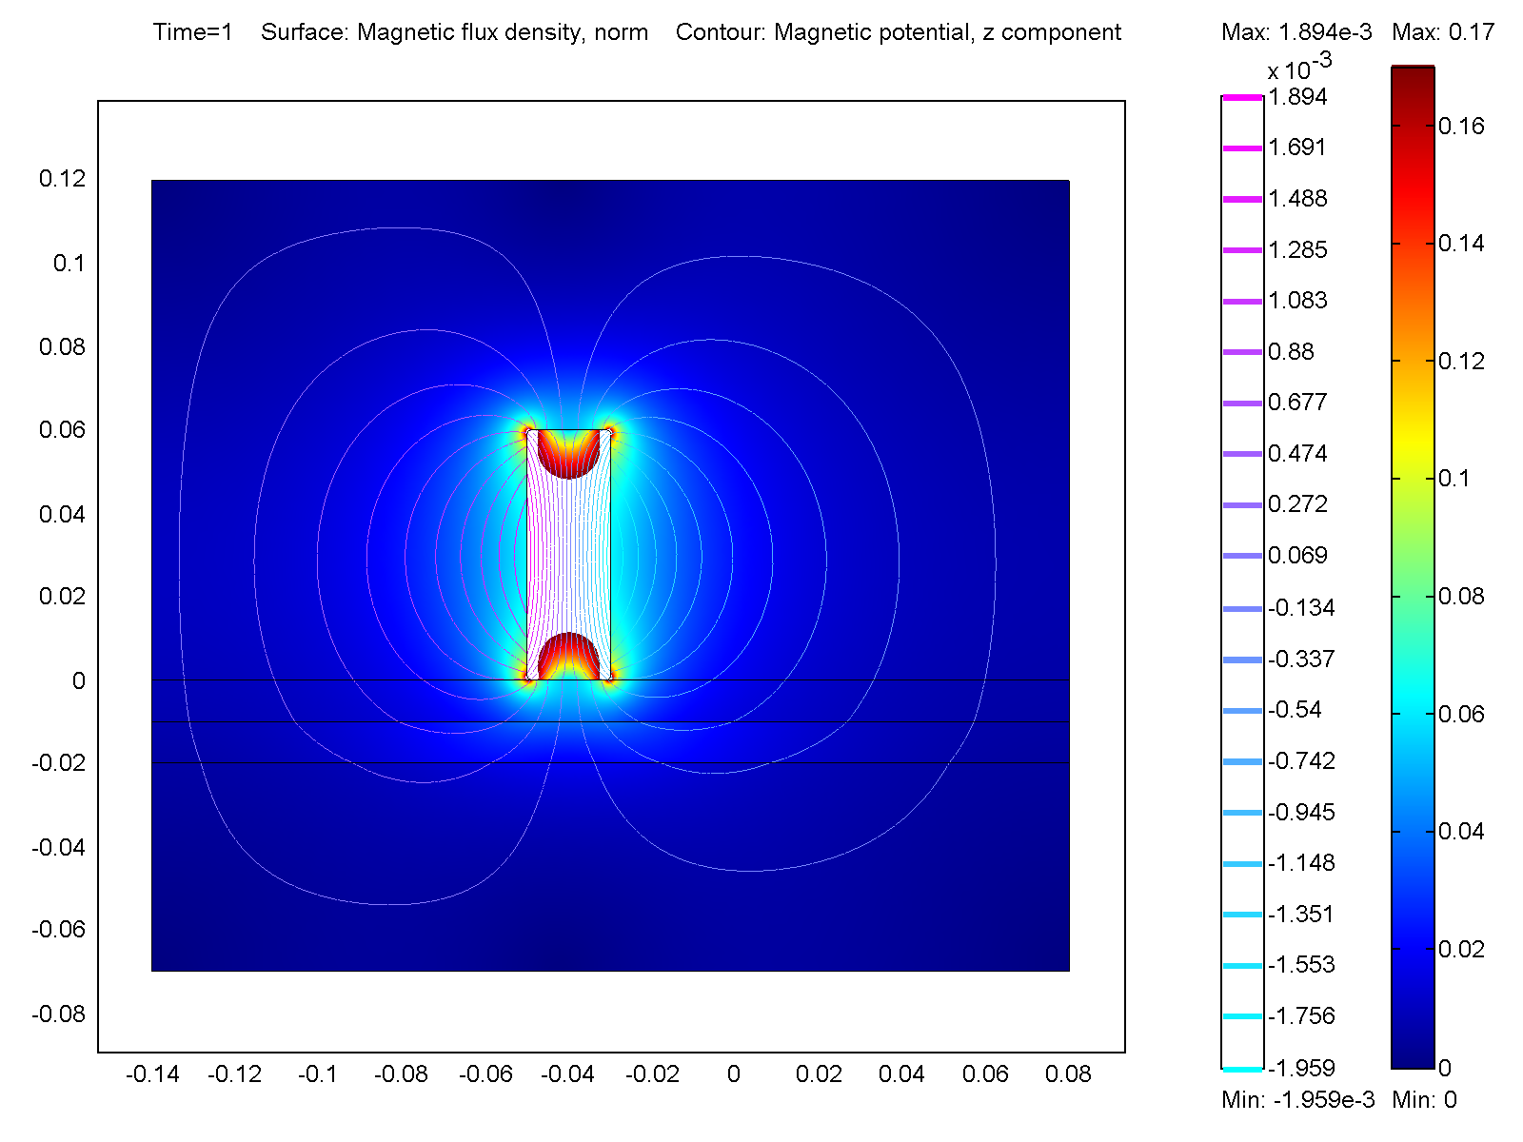
Results – magnetic field
The magnetic flux density has a maximum near the sharp corners. White areas are excluced from the plot range for clarity.
The interesting area is the blood vessel.

Slide 11
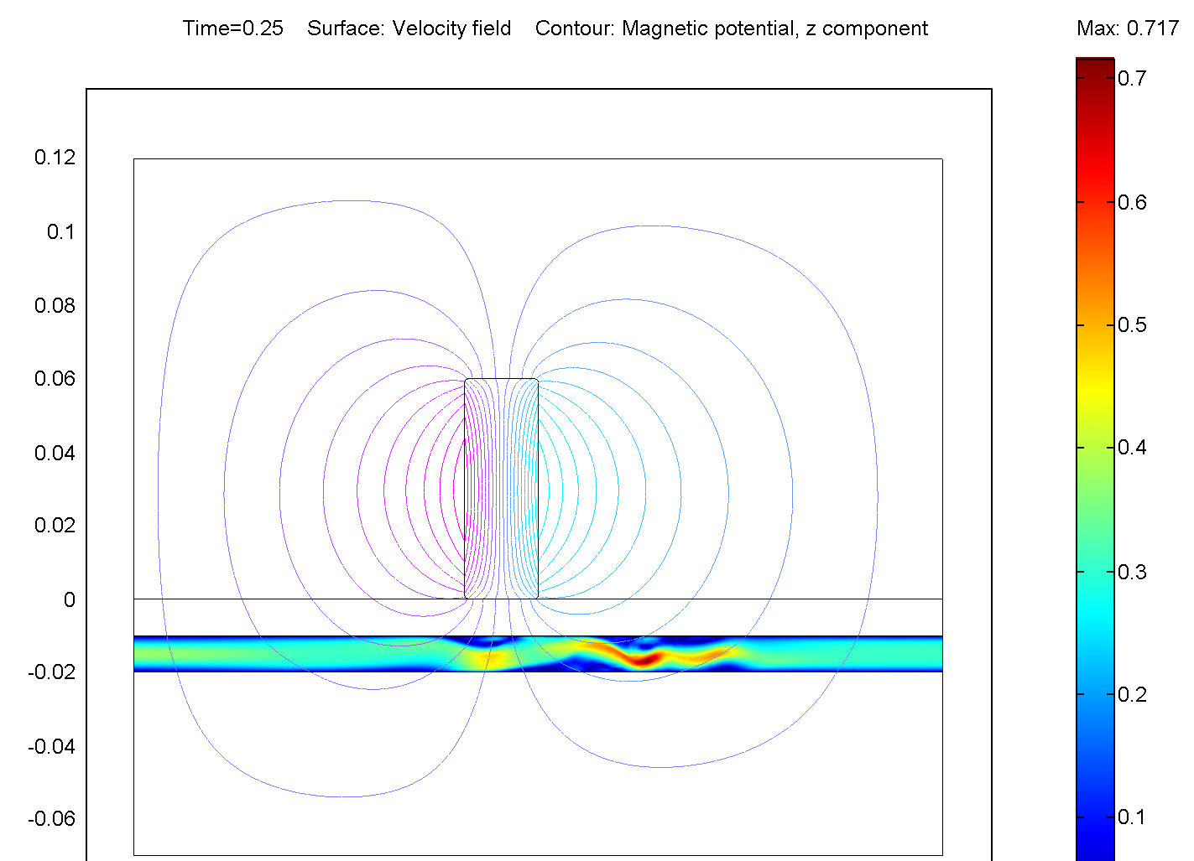
Results – Velocity Field at max blood throughput (heat beat), t=0.25.
The flow field is clearly distorted by the magnet

Slide 12
Results – Velocity Field at zero throughput, t=1
Even though the net flow is zero, we can see agitation in eddies generated by the magnetic field.

Slide 13
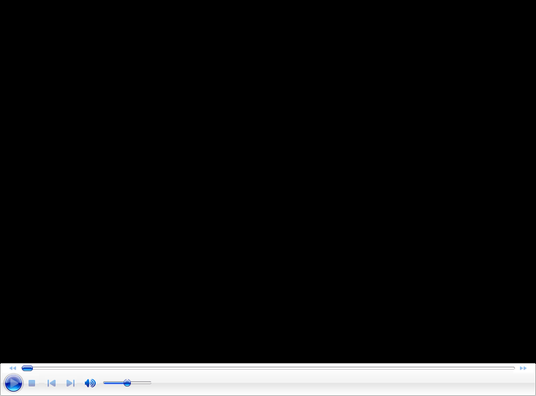
Results – movie

Slide 14
Results - Conclusions
Certain points near the magnetic disturbances will be exposed to a larger flow rate per unit area, (close to the reddish areas) whereas some parts will get less exposed (blue areas near vessel wall).
COMSOL Multiphysics is a good tool to test different flowrates and geometries to get guidance how to set up magnetic targeting equipment.

